Slide 1
Web Appraisal Sprint 6

Slide 2
Pre-sprint goals
Finish implementing customer views
Continue working on form functionality for appraiser views
Shift more focus to mobile UI
Photo upload functionality

Slide 3
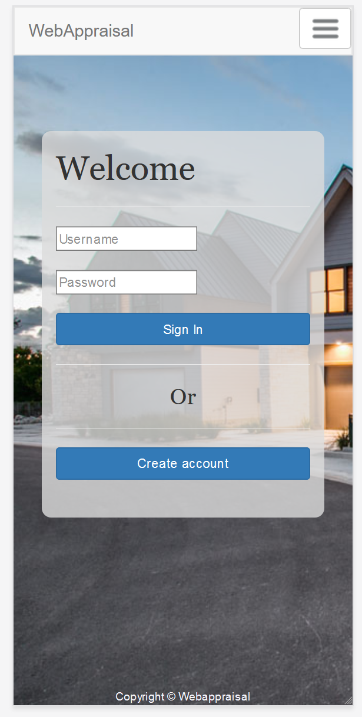
Where are we now?
Appraiser forms are fully functional
Customer views are implemented with mock data
Ability to take photos (mobile only) or upload photos has been added
Began researching and implementing mobile UI for login/home page

Slide 4
Sprint Challenges
Poor planning has resulted in a single file containing the view for all pages
Iterative additions has made it difficult to navigate
Intending on refactoring from functional → class-based views
Conflicting changes to database schema resulted in some time wasted debugging
UI changes are working on local view, but hosted view doesn’t appear the same

Slide 5
Demo!!

Slide 6

Mobile Demo

Slide 7
Next Sprint Objectives
Focus on mobile UI experience:
Have log in/account settings views functional on mobile
Begin adapting appraisal views
Continue applying photo taking/uploading to all pages
Start working on finding/displaying comparable houses

Slide 8
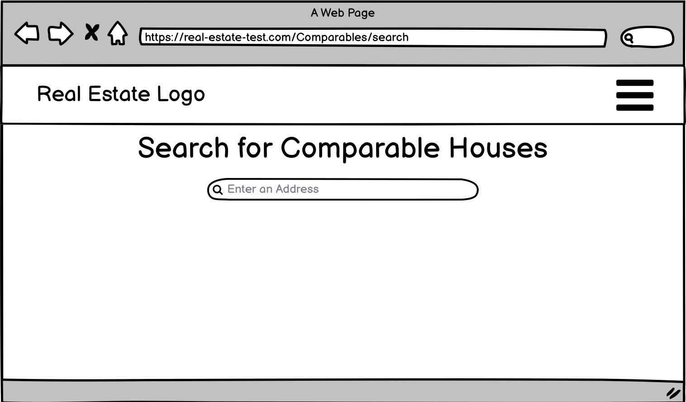
UI Mocks

Slide 9
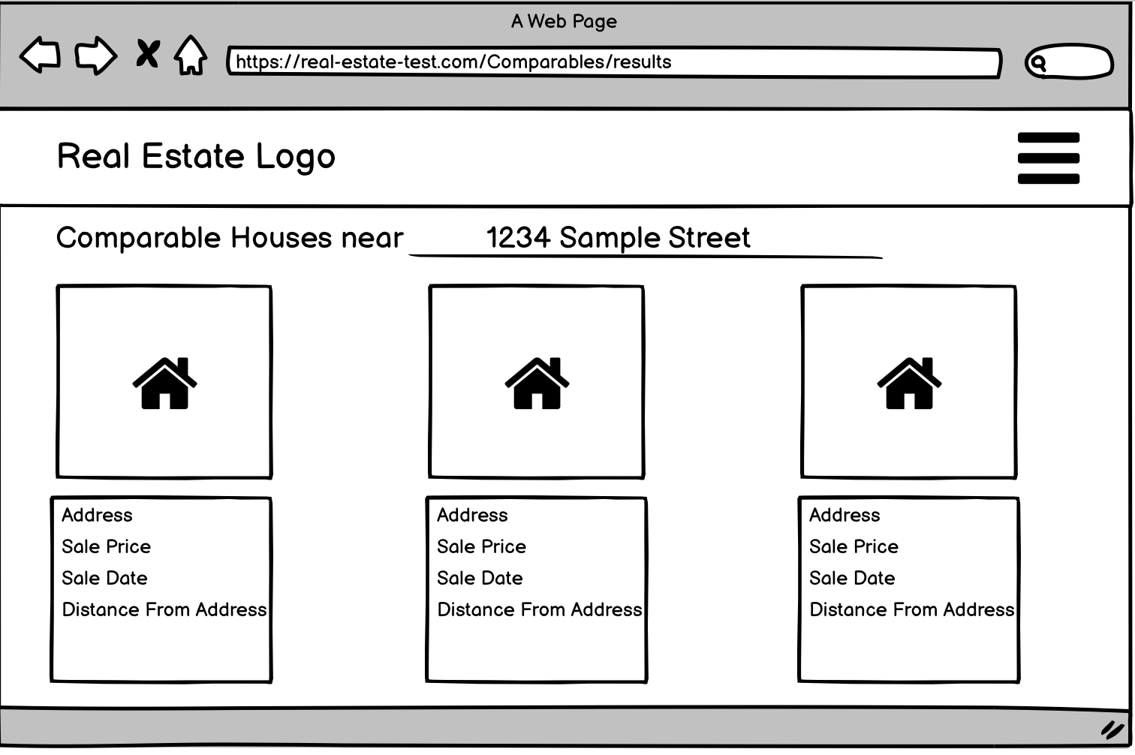
UI Mocks

